Slide 1
Capstone Project I
- Presented by Group 2
Anmol Sa
Muskan Agrawal
Nikhil Bhamere

Slide 2

PROJECT
SWIGGY ORDER ANALYSIS

Slide 3
Contents
Introduction
Dataset
Exploratory Data Analysis
Methodology
References

Slide 4
Introduction
Swiggy's order analysis is based on millions of orders Swiggy received on its platform as the largest food delivery platform in the country.
This project is focused on analyzing data related to the food delivery service provided by Swiggy. The project aims to provide insights into the trends and patterns in food delivery orders, highest ratings and restaurant performance on the Swiggy platform.
This analysis can also be used to improve the service provided by Swiggy to customers and restaurants, and to help in making data-driven decisions.

Slide 5
Dataset
Each restaurant in the dataset is uniquely identified by its Restaurant Id. Every Restaurant contains the following variables:
• Restaurant Id : Unique id of every restaurant across various cities of the world • Restaurant Name : Name of the restaurant • Country : Country in which restaurant is located • City : City in which restaurant is located • Address : Address of the restaurant • Locality : Location in the city • Locality Verbose: Detailed description of the locality • Longitude : Longitude coordinate of the restaurant's location • Latitude : Latitude coordinate of the restaurant's location

Slide 6
Dataset
• Cuisines : Cuisines offered by the restaurant • Average Cost for two : Cost for two people in different currencies • Currency : Currency of the country • Has Table booking : yes/no • Has Online delivery : yes/ no • Is delivering : yes/ no • Switch to order menu : yes/no • Price range : range of price of food • Aggregate Rating : Average rating out of 5 • Rating color : depending upon the average rating color • Rating text : text on the basis of rating of rating • Votes : Number of ratings casted by people
This Dataset contains 9553 rows and 21 columns.

Slide 7
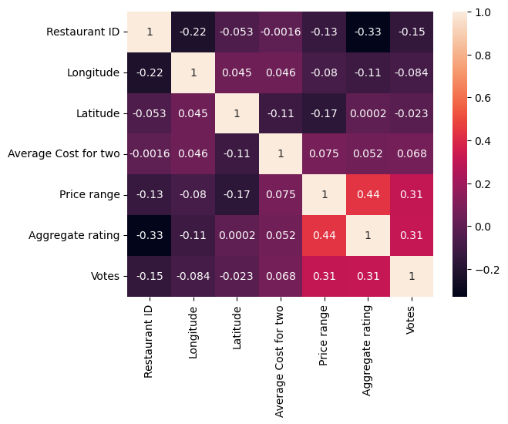
Exploratory Data Analysis (EDA)
Heatmap : From the picture below, we can observe correlation between two continuous variables.

Slide 8
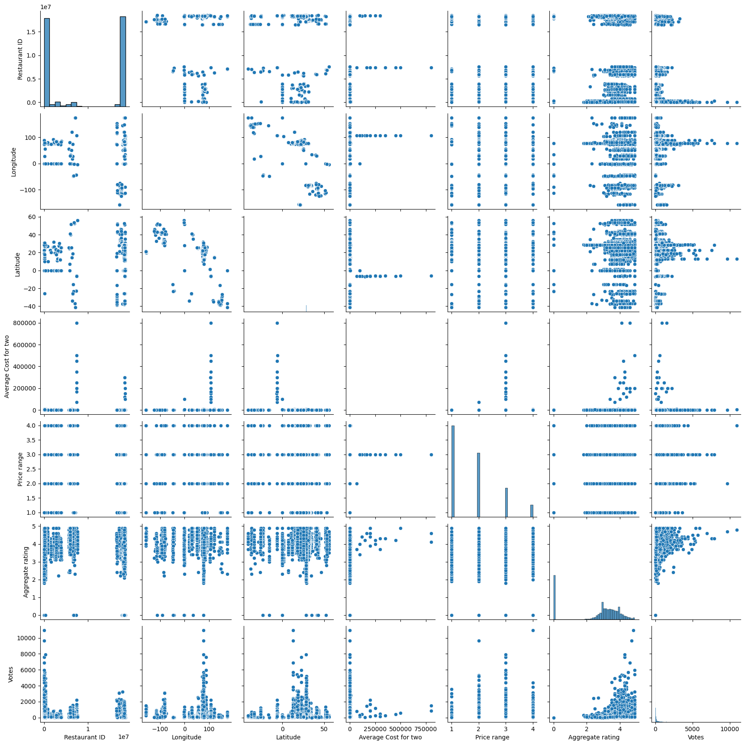
Exploratory Data Analysis (EDA)
Pairplot : From the picture below, we can observe the variations in each plot. The main-diagonal subplots are the histograms for each attribute.

Slide 9
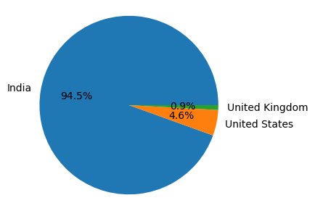
Exploratory Data Analysis (EDA)
Pie Chart : Here we have shown top 3 Countries which exposes most the Swiggy platform.

Slide 10
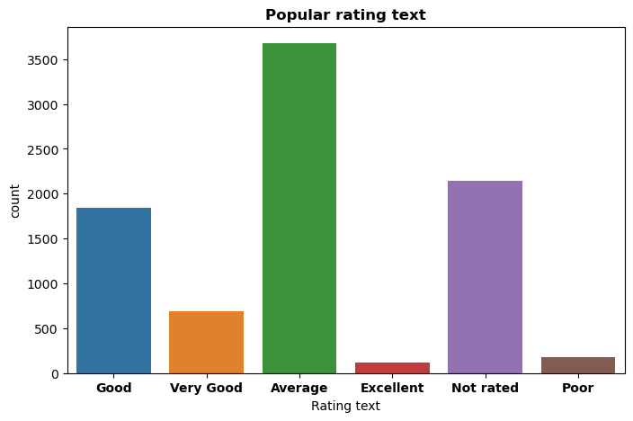
Exploratory Data Analysis (EDA)
Bar Chart : Here we have explored rating in India, and observed Average is the most popular rating text rated by Indians on Swiggy.

Slide 11
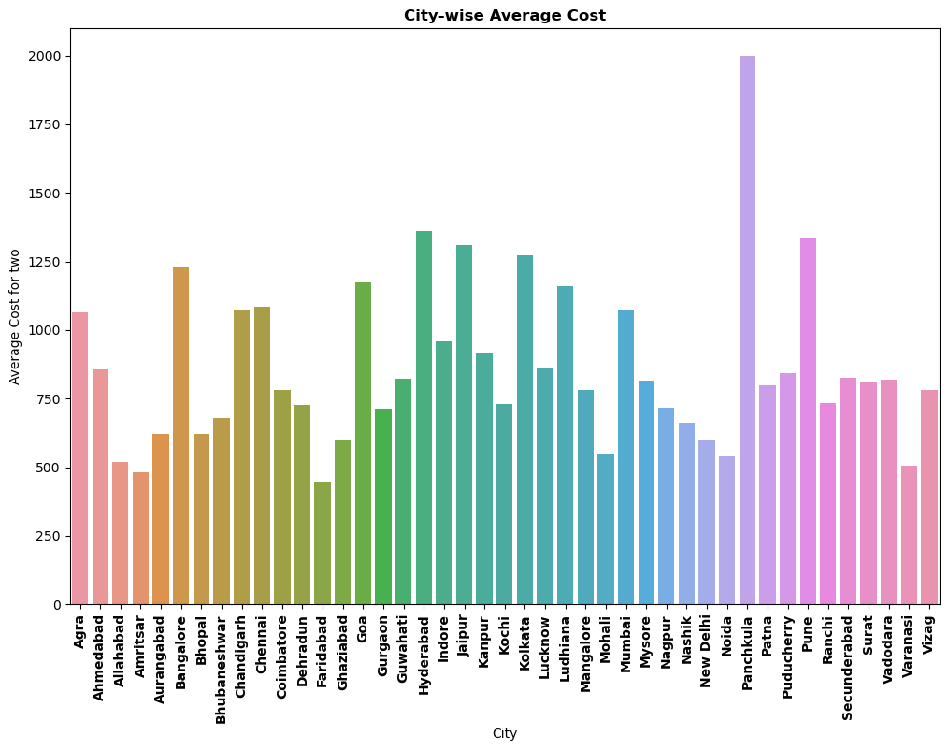
Exploratory Data Analysis (EDA)
Bar Chart : Here, we have shown average cost for two in cities of India.

Slide 12
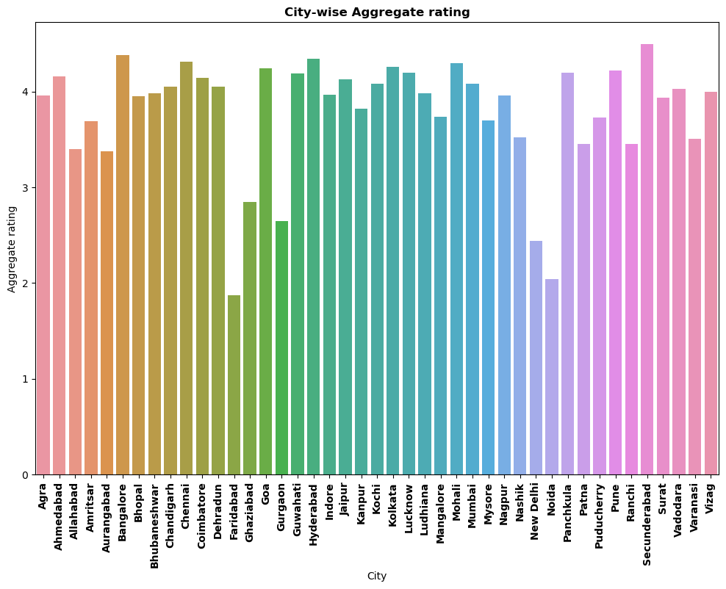
Exploratory Data Analysis (EDA)
Bar Chart : Here, the aggregate rating given by users to restaurants with respect to cities of India.

Slide 13
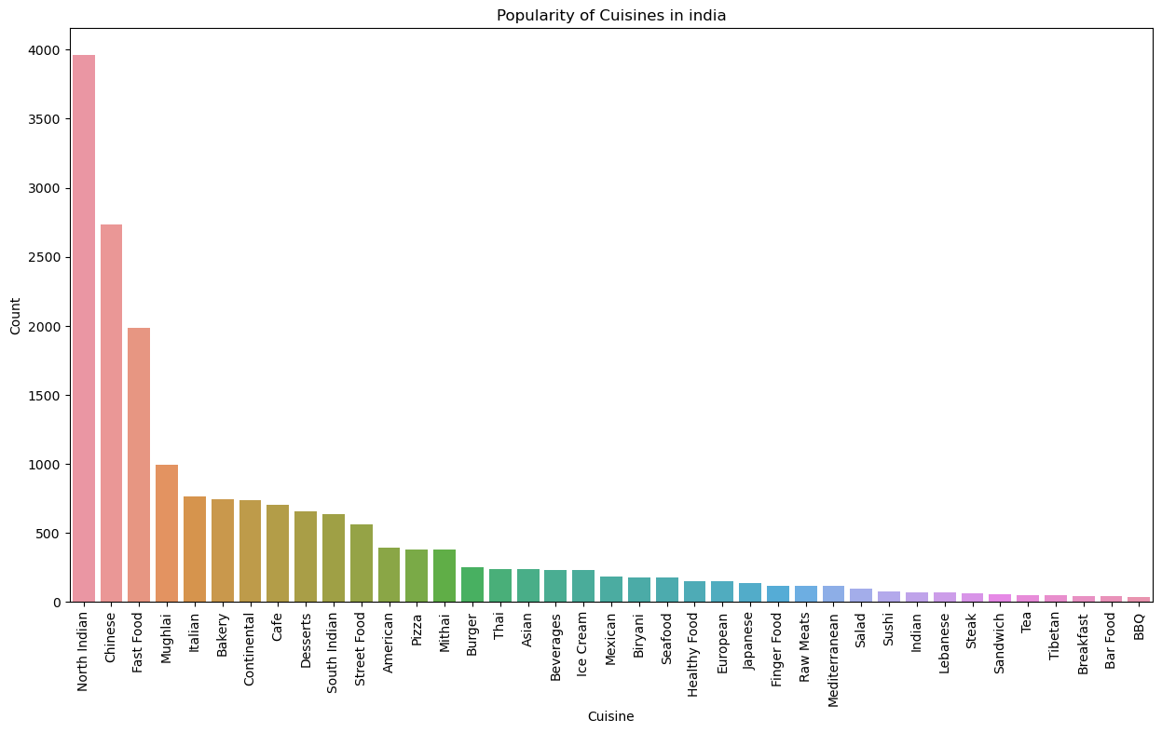
Exploratory Data Analysis (EDA)
Bar Chart : Here, top most popular cuisines in India.

Slide 14
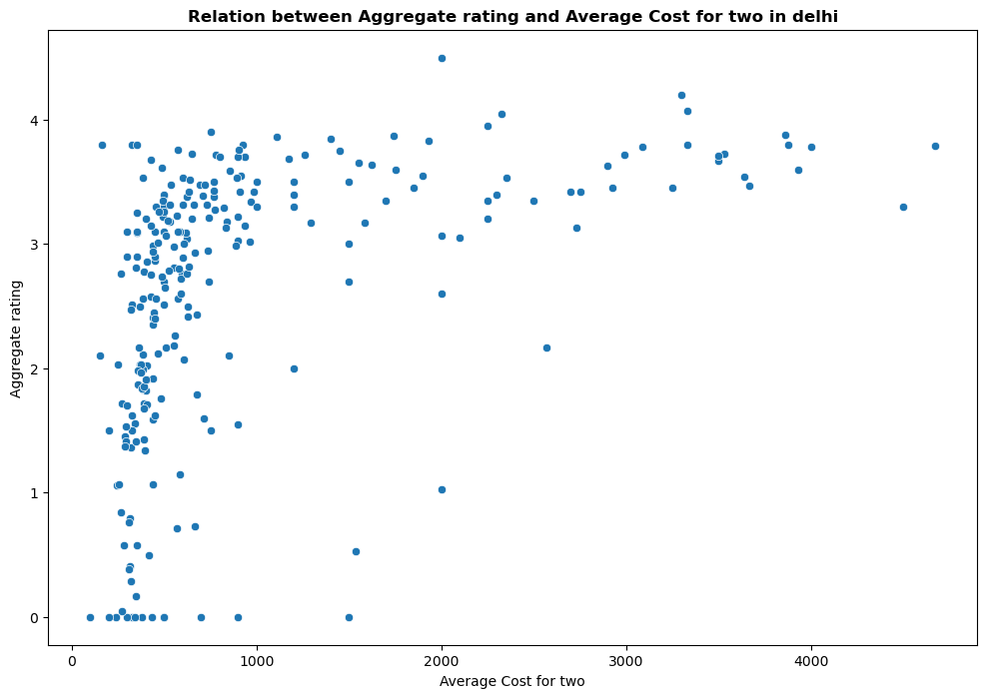
Exploratory Data Analysis (EDA)
Bar Chart : Here, we have shown relation between aggregate rating and average cost for two in Delhi.

Slide 15
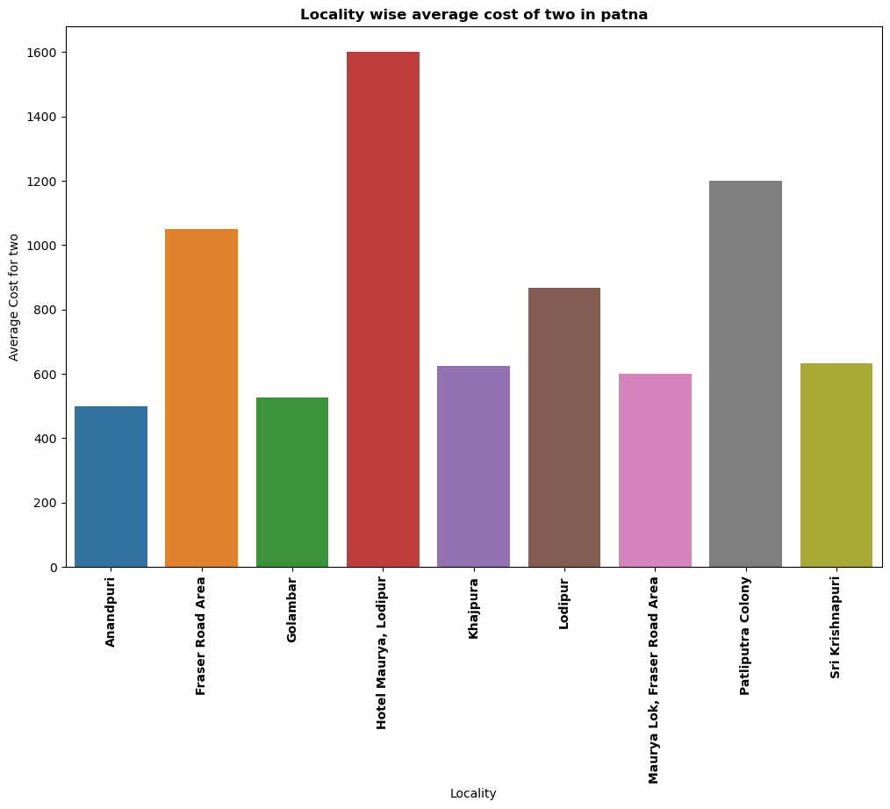
Exploratory Data Analysis (EDA)
Bar Chart : Here, we have shown average cost for two in Patna with respect to locality.

Slide 16
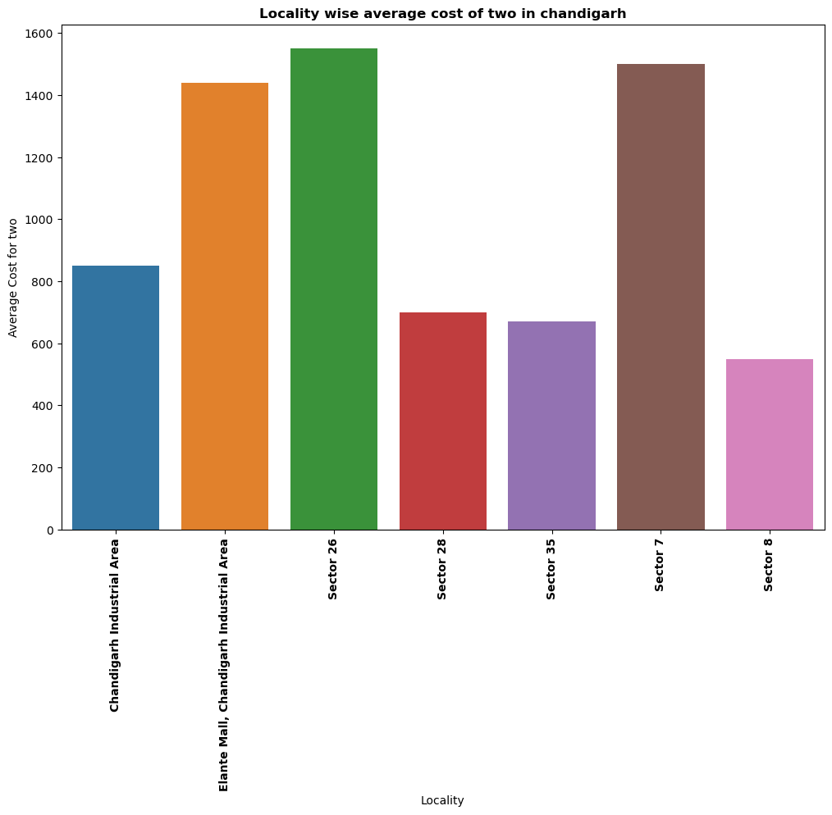
Exploratory Data Analysis (EDA)
Bar Chart : Here, we have shown average cost for two in Chandigarh with respect to locality.

Slide 17
Methodology
Train Test Split : We have split our data to train and test, 70% and 30% respectively.
Standard Scaler : We have standardized our data values into a standard format.
Linear Regression : We have performed Linear Regression, which is Supervised Machine Learning Algorithm. It is used to predict the value of a variable based on the value of another variable. The variable you want to predict is called the dependent variable. The variable you are using to predict the other variable's value is called the independent variable.

Slide 18
References
EduBridge Course Material
Kaggle.com
YouTube
GitHub

Slide 19

THANK YOU

